Slide 1
Lecture Module 4: Collecting and Monitoring EEG
NDCLab
Florida International University
George Buzzell does not take credit for any of the images presented in these lecture slides. If not otherwise indicated, all images were sourced from materials available from Steven J. Luck, Michael X. Cohen, or identified through generic google image searches. Appropriate credit for all images/figures can be identified through a reverse image search or by requesting this information directly from George Buzzell at gbuzzell@fiu.edu. The theory presented in these lectures are taken predominantly the EEG books and videos by Michael X. Cohen and Steven J. Luck.

Slide 2
Module overview
General guidelines and best practices for EEG
General EEG data collection protocol
Monitoring data collection
Specific issues and how to troubleshoot
Overview of system/study-specific differences
Following module: Tour of data collection rooms

Slide 3
General guidelines and best practices for EEG

Slide 4
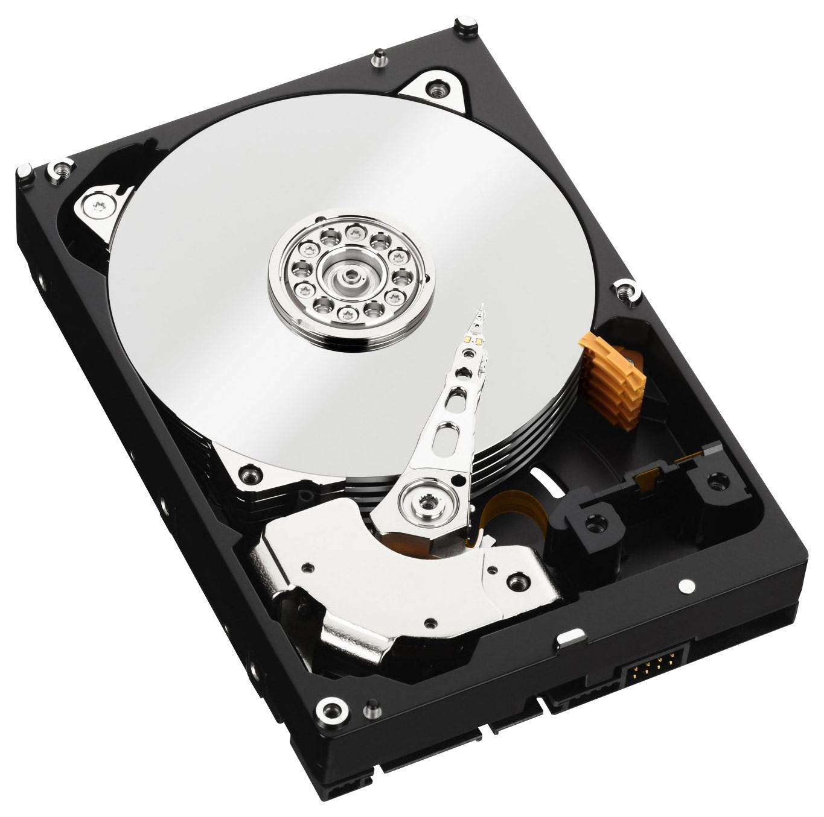

General principles
Control everything you can, if you can’t control it, measure it
This goes for stimuli, experimental paradigms, participant procedures, data collection procedures
Try to record less, good task data, than more bad task data
Data storage is cheap, let the recording run even during periods you think might not be important
Take meticulous notes of everything!

Slide 5
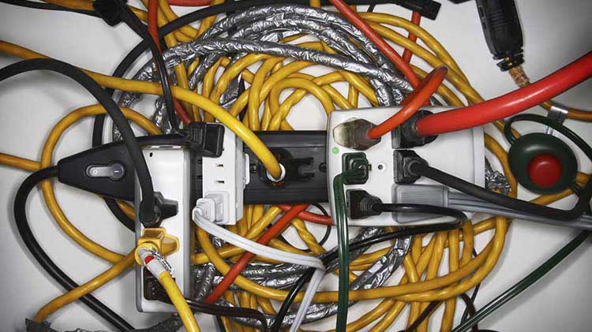
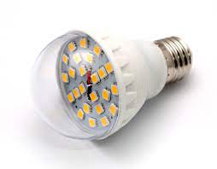
Minimize noise
Ideal recording set-up:
Electrically shielded participant room
All computers and nearly all other electrical devices, cords, etc. outside of participant room
Cords and equipment inside participant room are shielded
If can’t shield wires, at least do not let them coil/tangle!
LED monitor and lighting
No metal contacts with participant
No personal electronics in room

Slide 6

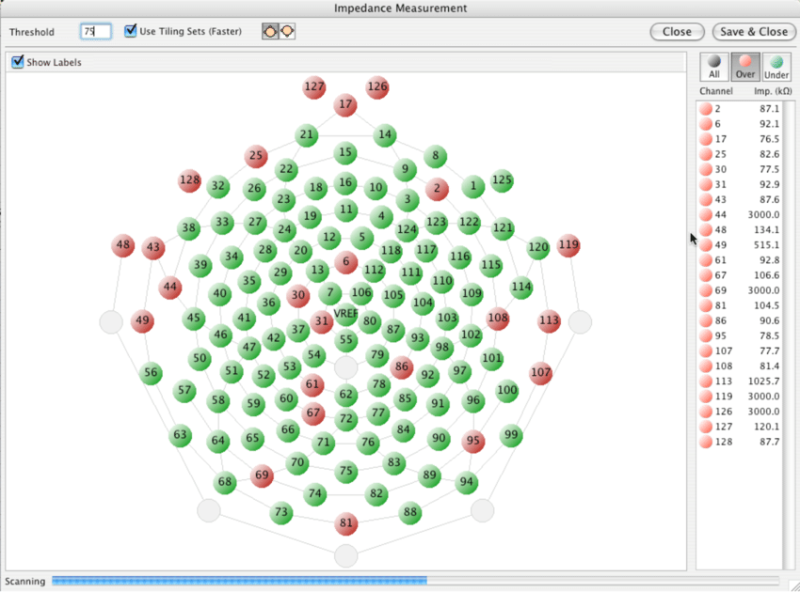
Impedance
Remember: Lower impedance = less noise
Less noise = better data
It is is much easier to detect neural effects with a few subjects that have a short amount of good data, than lots of subjects with lots of bad data
Lower impedance = more publications = getting into grad school, a postdoc, landing a faculty job, being awarded tenure!
Save impedance values if you can and record when you adjust
Keep track of time since last impedance check

Slide 7
EEG data collection settings
Recording parameters vs display settings
Recording: keep as much as possible
Filter as close to dc offset as possible
No low pass or at Nyquist
Sample at least at 250 Hz (1000 great)
Display: similar to final product
.3 highpass, 30 hz low pass
Takes a few seconds to kick in

Slide 8
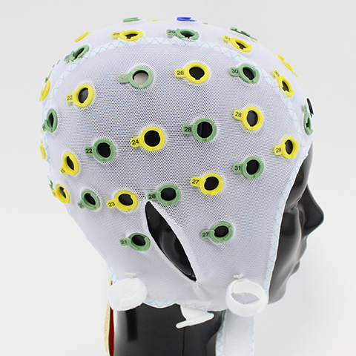
Good lab practices
Back up data immediately following collection.
Should be in 3 places within a 48 hours
Log system usage
Log computer and net usage to track down systematic problems
Perform regular, monthly timing tests of system and your tasks (record)
Rotate net usage
Check net impedance/quality monthly
Report issues!
No one gets upset if you make a mistake, people get very unhappy if you make a mistake and don’t tell people
Report anything that looks odd, even if it has been like that for a while and you just noticed it
Institutional knowledge is not always right!

Slide 9
Interim summary
Control everything possible. Note everything you can’t control
Minimize noise via how room is set up and by lowering impedance
Collect data using least restrictive settings, but use a display filter
Back up data
Regular tests/checks of equipment; log usage; rotate nets
Better to collect less good data than more bad data

Slide 10
General EEG collection protocol

Slide 11
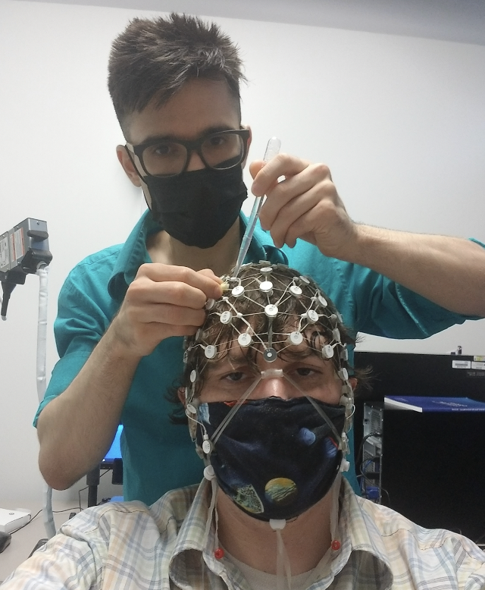
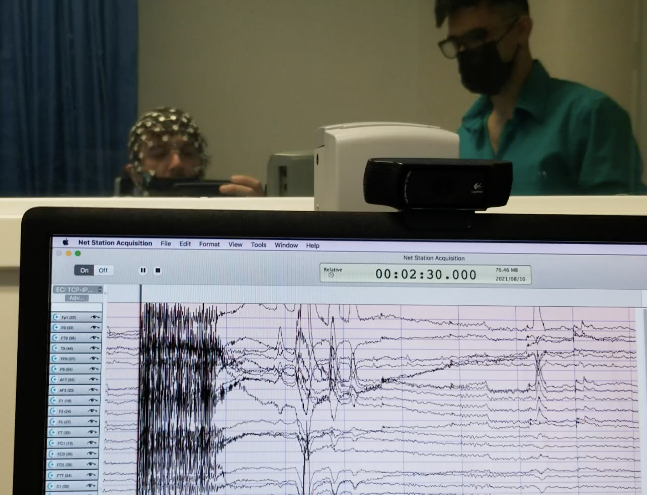
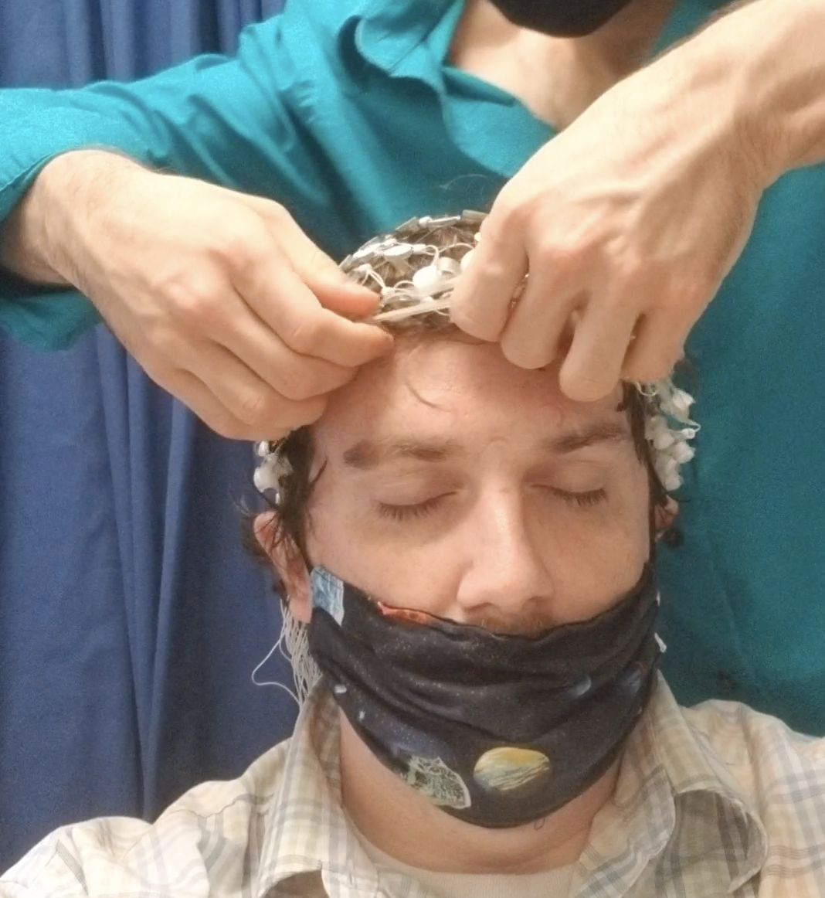

Basic EEG protocol
Prepare equipment and room
Explanation of EEG to participant and cap selection
Capping
Demonstration of artifacts to participant
Explanation of task instructions
Data collection session(s) and monitoring
Cap removal and participant debrief
Cleaning and locking-up supplies
Backing up data and finalizing notes

Slide 12

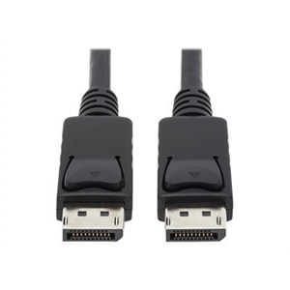
1. Prepare equipment and room
Ensure all needed task stimuli/equipment, as well as all EEG equipment and supplies are present
Set up task stimuli and equipment
Ensure all cables are properly connected

Slide 13

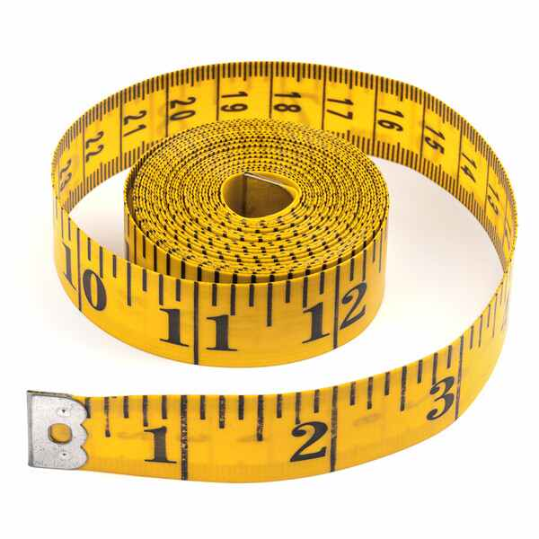
2. Explanation of EEG to participant and cap selection
The most important aspect of any study is participant consent
Important that participant is made aware or EEG procedure during consent
Before beginning capping, important that participant understands what is involved
Before each step involving doing something to the participant (e.g., measuring head) explain what you are doing
Measure head and select appropriate cap; prepare with electrodes, etc.

Slide 14
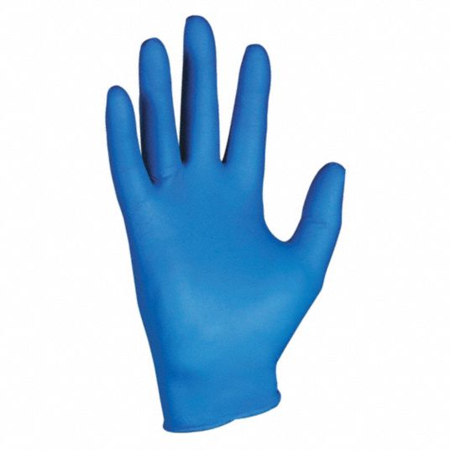
3. Capping
Wear gloves, maintain constant communication with participant
Work to apply the cap as quickly as you can without sacrificing quality
Ensure best connection possible for electrodes without causing discomfort for participant
Ensure cap is properly sized, and properly centered front-to-back and left-to-right
Have second person confirm
Work to adjust impedance for all electrodes; start with ground and reference
Ensure all impedances (or at least key electrodes) at appropriate levels

Slide 15
4. Demonstration of artifacts to participant
Allow participant to view real-time EEG data collection
Explain that we cannot tell what they are thinking by looking at it
Explain we can tell if data quality is good or not
Explain how brain signals are small, but artifacts large and need their help to reduce artifacts
Demo blinks, saccades, eyes closed, muscle tension
Ask them to limit these during study; note we may remind them

Slide 16

5. Explanation of task instructions
Ensure that participant is comfortable
Ensure that they fully understand all task instructions
Most tasks will involve a practice session to confirm understanding
Data collected from someone that does not understand the task is not usable

Slide 17

6. Data collection session(s) and monitoring
Make sure data is recording!!
Ensure all task events are operating as expected and all task markers are being sent
Ensure data quality is/remains good. Intervene as necessary
Ensure participant remains comfortable, alert, and performing task properly
Monitor and control surrounding environment (limit noise, presence of others)

Slide 18
7. Cap removal and participant debrief
Carefully remove the cap!
Help participant to wipe away gel, saline, etc.
Answer any questions/debrief

Slide 19

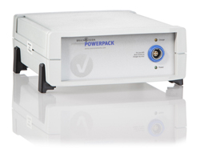
8. Cleaning and locking-up supplies
Clean and disinfect EEG cap/electrodes
Dispose of all garbage properly
Clean up room and equipment as needed
Lock up all supplies and set batteries to recharge

Slide 20
9. Backing up data and finalizing notes
The study is not complete until all data is backed up in at least two locations and all notes are finalized
It is not a question of IF, but WHEN hard drives or servers will faili
If data exists in only one location, then it is NOT permanent!
All data should be backed up immediately following the study
Data cannot be properly analyzed if pertinent information is missing; notes of all abnormalities, etc., must be finalized

Slide 21
Interim summary
Maintain good communication with participant
Ensure participant understands task instructions
Apply the cap as quickly as possible without sacrificing data quality or causing discomfort
Monitor participant, task, EEG, and the environment
Data that is not backed up is not permanent
Clean up!

Slide 22
Monitoring Data Collection

Slide 23
Stay vigilant!
Once the study is set up and running, it is tempting to use the time to read, surf the internet, or study for a class. Please do not do this!
Nearly every EEG study that I have ever run has at least one abnormality arise that needs to be dealt with
It is crucial that you continue to closely monitor the EEG, task, the participant, and the surrounding environment.
Where appropriate, intervene to improve/maintain data quality
Call supervisor if you cannot fix issue (or are unsure at all)
It is a waste of time to be meticulous in set up only to collect unusable EEG

Slide 24
Task monitoring
Take special note that all study equipment/stimuli are operating properly at the start of the task
This is the time that something is most likely to malfunction
Continue to (re)check that all study equipment/stimuli are operating properly throughout the task
Be especially sure that event markers are being transferred properly
Correct any issues as appropriate; record all abnormalities in the tracker

Slide 25
Participant monitoring
Make sure the participant is comfortable and that they understand all task instructions
Ensure that the participant continues to engage in the task properly
Make sure the participant does not fall asleep!
Offer snacks/drinks as allowed by the study guidelines (some studies will prohibit, though)

Slide 26
Environment Monitoring
Stay alert to the surrounding environment (noise, temperature, humidity, presence of others)
Note any abnormalities in the tracker
Maintain a controlled environment (as much as possible) in terms of noise and the presence of others
Don’t be afraid to politely ask others to keep their voice(s) down.

Slide 27
EEG Monitoring
The most important thing to monitor is the quality of the EEG data being recorded
It is very rare for an entire session of data to be collected with no abnormalities.
You need to understand what various abnormalities reflect, whether you should do something about them, and if so, what (and when)
It takes time to become experienced with monitoring EEG
The main determinant of whether someone is ready to collect EEG on their own is their skill in monitoring and troubleshooting EEG data quality

Slide 28
General comments on monitoring/troubleshooting
Never intervene during a block of task, only during breaks.
Only try to fix issues that are affecting a majority of electrodes, the ground/ref, or one of the key electrodes for the study
Do not bother/disturb the participant to fix a “non-essential electrode”.
When you try to fix an issue, the amount of time spent trying to fix it depends on the issue.
Before trying to fix any issue, double check that the time and voltage scale are at the “default values” for this study.
Also, keep in mind that ”good EEG” looks different at different settings and across studies/systems.
If you are uncertain how to fix an issue, do not hesitate to call the study lead (or proxy).

Slide 29
Interim summary
Stay vigilant throughout the entire study, and monitoring the task, participant, environment, and EEG
Ensure markers coming through, environment is controlled, participant awake, comfortable and understands the task, and the EEG quality is good.
Call supervisor if you cannot fix issue (or are unsure at all)

Slide 30
Specific issues and how to troubleshoot

Slide 31
Specific issues
In the following slides, we present some of the most commonly seen issues arising during EEG data collection
We explain what the issue is, whether something should be done, and if so, when and how to address the issue
For any issue, only try to address it during a break, not during the actual task.
As always, these general guidelines are over-ridden by system or study-specific protocols.
It will take time for you to become comfortable identifying/correcting issues
Never hesitate to ask for help, and remember that it takes time to develop expertise

Slide 32
Excessive alpha activity
Presents as large oscillations repeating about 8-12 times/sec in adolescents and adults or 6-9 times/sec in infants and young children
Dominant over occipital/parietal electrodes
Will be present over several electrodes or more
Will tend to wax and wane in prominence
OK only maximal for short periods (few seconds)
If sustained for more than 10-20 seconds, or, if it appears to wax and wane in a predictable pattern need to confirm that participant is not repeatedly closing their eyes and/or asleep.
Not uncommon for undergrads to do this (maybe 1/30)

Slide 33
Heart rate in EEG
Presents as a regular triangular pattern in the EEG, which repeats ever .5 – 1 seconds
Typically most prominent in electrodes near temples or around the ear
Totally fine and nothing that you need to do
Can’t easily be fixed anyways…

Slide 34
Excessive Blinks
Each blink will present as a single large amplitude deflection lasting ~.5 – 1 seconds
Almost always present in multiple electrodes and always largest in those near the eyes
The amplitude of blink deflections is larger closer to the eyes (>100 uv near the eyes)
Blinks are expected and not a problem as long as they occur < one time every ~10 seconds
If they occur more than once every 5 seconds then participant should be reminded to limit blinks
Participant can be notified up to 3 times.

Slide 35
Saccades
Presents as a “box car” in one or more electrodes near the eyes
Length of “box car” depends on length of the saccade, but typically ~.5-1 seconds
Almost always present in multiple electrodes and always largest in those near the eyes
The amplitude of saccades depend on the specific saccade but typically (>50 uV near the eyes)
Whether or not saccades are a problem is entirely dependent on the study
For most computer-based studies, with central presentation of stimuli, saccades should not occur
If saccades are a problem for the study, the participant should be reminded of this (up to 3 times).

Slide 36
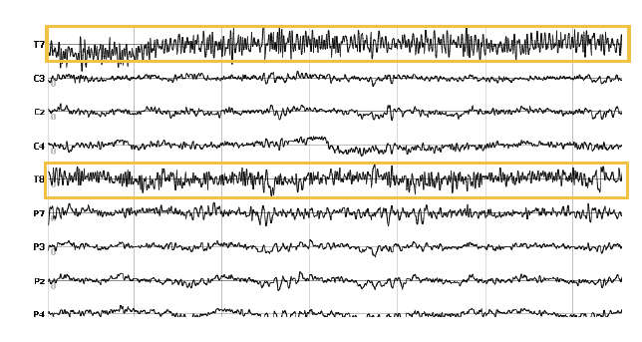
Excessive EMG
Presents as higher frequency (20-40 Hz) activity in multiple electrodes
Affected electrodes will appear “darker” or “thicker” and may also include large amplitude, irregular low-frequency (.1-4 hz) activity as well
Can be in a relatively small group of electrodes, or present in all
Can wax and wane or be sustained
Participant should be notified of issue up to 3 times.
What to do:
Immediately:
If it is difficult to identify which electrodes are affected, increase the voltage scale (larger number) until you are able to see individual EEG traces
Note if all channels are equally noisy or it is one or more select channels
If a select group of channels, note the location of these electrodes (near eyes, ears, or back of head
At next break:
Ask participant to relax their face, neck and shoulder muscles
Note the particular muscle group showing tension (if known)
If asking participant to relax does not resolve issue, then it is not an EMG issue. Need to fix select electrodes or ground/ref, pending whether subset or all electrodes affected

Slide 37
Line noise
Presents at high-frequency (50/60 Hz activity); will make EEG channels affected appear “darker” or “thicker”
Might be present in one electrode, a group of electrodes, or equally in all electrodes
If present in all electrodes equally, then this reflects an issue with the ground or references and is more important to fix
What to do:
Immediately:
Check the time/voltage scale and ensure at proper settings
Confirm visual filter is on
Try increasing the voltage scale (larger number) until you are able to see individual EEG traces
Note if all channels are equally noisy or it is one or more select channels
At next break:
If only one or a few electrodes are bad, fix those by adding a half-grain amount of gel and abrading scalp
If all channels equally bad, it is likely the ground or reference that need to be fixed.
Add a half-grain amount of gel and abrading one, then other. If improving, continue until fixed.

Slide 38
Irregular EEG data
Presents as a combination of low-frequency, high amplitude activity, with or without additional high frequency activity as well
No clear pattern to the data
Channel has likely become disconnected.
If present in a key study electrode, then critical to fix. Spend up to 5 minutes attempting to address single electrode, and, attempt to fix up to three times.
If present in all electrodes, spend as much time as needed. Data not usable in this state.
What to do:
Immediately:
Check the time/voltage scale and ensure at proper settings
Confirm visual filter is on
Try increasing the voltage scale (larger number) until you are able to see which electrodes are affected.
At next break:
If only one or a few electrodes are bad, fix those by adding a half-grain amount of gel and abrading scalp
If all channels equally bad, it is likely the ground or reference that need to be fixed.
Add a half-grain amount of gel and abrading one, then other. If improving, continue until fixed.

Slide 39
Electrode drift
Presents as very low frequency (<.5 hz), very high amplitude “drift” in one or more electrode
Channel has become disconnected
If present in a key study electrode, then critical to fix. Spend up to 5 minutes attempting to address single electrode, and, attempt to fix up to three times.
If present in all electrodes, spend as much time as needed. Data not usable in this state.
What to do:
Immediately:
Confirm visual filter is on
Try increasing the voltage scale (larger number) until you are able to see which electrodes are affected.
At next break:
If only one or a few electrodes are bad, fix those by adding a half-grain amount of gel and abrading scalp
If all channels equally bad, it is likely the ground or reference that need to be fixed.
Add a half-grain amount of gel and abrading one, then other. If improving, continue until fixed.

Slide 40
Electrode data missing
Presents as an “empty” channel with no data being recorded
Channel has likely become disconnected.
Might actually be very low frequency, very high amplitude data being collected (changing scale will reveal)
If present in a key study electrode, then critical to fix. Spend up to 5 minutes attempting to address single electrode, and, attempt to fix up to three times.
If present in all electrodes, spend as much time as needed. Data not usable in this state.
What to do:
Immediately:
Check the time/voltage scale and ensure at proper settings
Confirm visual filter is on
Try increasing the voltage scale (larger number) until you are able to see which electrodes are affected.
At next break:
If only one or a few electrodes are bad, fix those by adding a half-grain amount of gel and abrading scalp
If all channels equally bad, it is likely the ground or reference that need to be fixed.
Add a half-grain amount of gel and abrading one, then other. If improving, continue until fixed.

Slide 41
Black or mostly-black EEG window
Presents as a complete or nearly complete black EEG window instead of individual EEG traces
Critical to fix. Spend as much time as needed to fix, as data is not usable at all in this state
What to do:
Immediately:
Check the time/voltage scale and ensure at proper settings
Confirm visual filter is on
Try increasing the voltage scale (larger number) until you are able to see individual EEG traces
Note if all channels are equally noisy or it is one or more select channels
At next break:
If only one or a few electrodes are bad, fix those by adding a half-grain amount of gel and abrading scalp
If all channels equally bad, it is likely the ground or reference that need to be fixed.
Add a half-grain amount of gel and abrading one, then other. If improving, continue until fixed.

Slide 42
Interim summary
For any issue, only try to address it during a break, not during the actual task.
The amount of time spent dealing with an issue depends on how much it impacts the primary electrodes of interest.
Never hesitate to call the supervisor if you are unsure about an issue. Remember that it takes time to develop expertise.

Slide 43
Overview of system/study-specific differences

Slide 44
System and study-specific protocols
We have covered generic best practices for EEG data collection and the typical protocol followed for most systems/studies
These guidelines should always be followed, for all studies/systems unless otherwise specified in a system- or study-specific protocol
Specific protocols always “override” generic protocols
We will be developing a system-specific generic protocol and video walk-through for each of our three systems
Additionally, any study you run in this lab, EEG or otherwise will also always include a study-specific protocol to follow

Slide 45
System-specific differences
Non-exhaustive list of differences across systems:
Software used to acquire EEG
Influences specific steps followed for set-up and monitoring
Method of sending markers to EEG
Influences monitoring and troubleshooting of markers
Cap electrode numbers, names, placement, style
Influences capping and cleaning
Influences what artifacts look like
Signal-to-noise ratio and gain
Influences monitoring and what “good” EEG data looks like

Slide 46
Study-specific differences
Non-exhaustive list of differences across studies:
Location of study
Influences set-up and EEG monitoring
Whether the study is computer-based or “real-world”
Influences monitoring and troubleshooting of markers
Influences source of markers, and number of sources (computer, camera, etc.)
The kind/amount of motor activity of participant
Influences monitoring and what “good” EEG data looks like
Threshold for intervening
Length of study
Influences participant and EEG monitoring

Slide 47
Interim summary
Always follow the general guidelines unless overridden by a system or study-specific protocol
Specific steps associated with collecting EEG, as well as what “good EEG” looks like, will differ across systems/studies
We will be creating system-specific protocols, for all three systems, this semester
Every study you run will always have a study-specific protocol

Slide 48
Questions?
Next up: Tour of data collection rooms

